Slide 1

Automatic Class Attendance System Based On Face Detection And Recognition
Rohan Anil Tade
Deepesh Saroj
Prabhat Thakur
Bhavi Chavhan

Slide 2
Outline :
1. Introduction
2. Algorithm ( flow chart )
3. Functional Block Diagram
4. Results
5. Conclusion
6. Future Work

Slide 3


Introduction :
Traditionally attendance is marked manually by teachers and they must make sure correct attendance is marked for respective student.
This whole process wastes some of lecture time and part of correct information is missed due to fraudulent and proxy cases.

Slide 4
Introduction :
In order to determine classroom attendance, face detection and face recognition are performed. Face detection is used to determine the location of the faces in the classroom image and extract sub images for each face. Then, in face recognition, the face images detected will be compared with the data base consisting of images of students in the class, and attendance will be recorded accordingly.

Slide 5




Significance:
1-Automated
2- Economically
3-Effective
4- Keep extra time

Slide 6
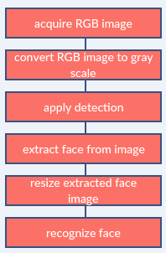
Image processing:

Slide 7
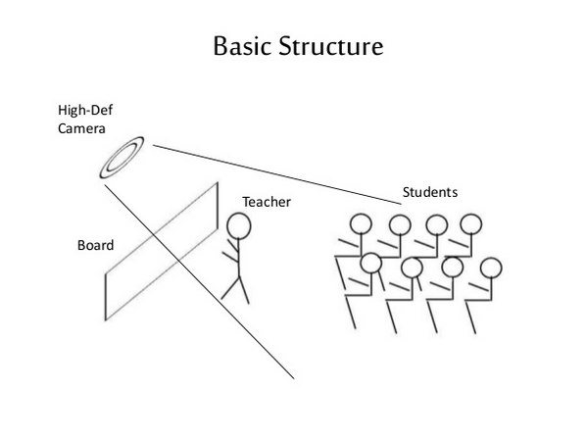

Slide 8
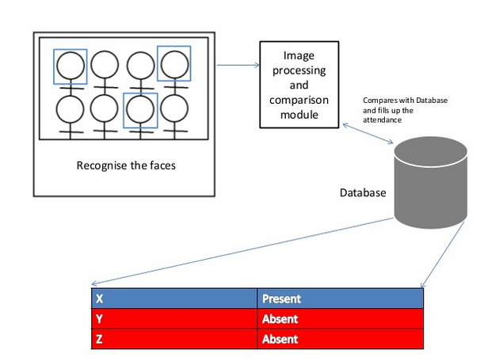

Slide 9
Face Detection:
Face detection is a computer technology used to identify human faces in digital images by determining the location of the faces in the image and extract sub images for each face.
Viola Jones algorithm will be implemented to recognize face and non-face patterns and enable us to identify locations of the faces in the image.

Slide 10
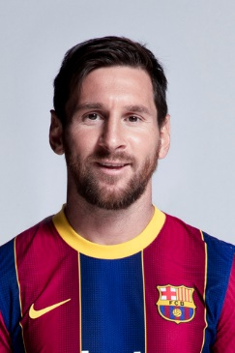
Example for detect face :
Detection of Face

Slide 11
How Do We Create Database
Database is the collection of face images and extracted features. And the database includes names of students , Date &Time for each student .
We created a data base for students, were we took images per students using Web CAM, these images were taken at different times and with variations in illumination, facial expressions, and facial details.

Slide 12
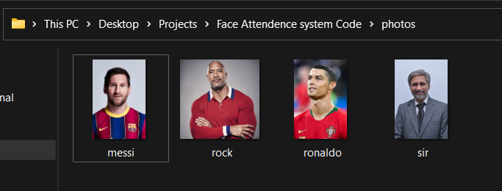
Example for data base images:

Slide 13
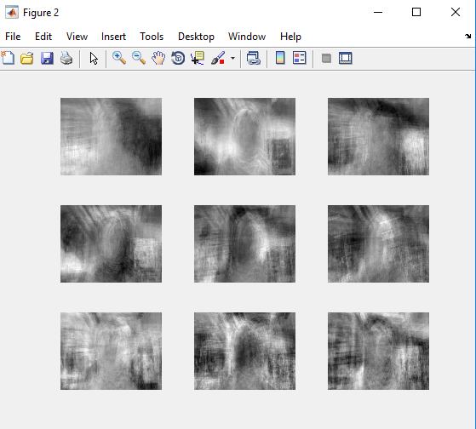
Top 9 Eigenfaces from our Images

Slide 14

Text file for present students information:

Slide 15
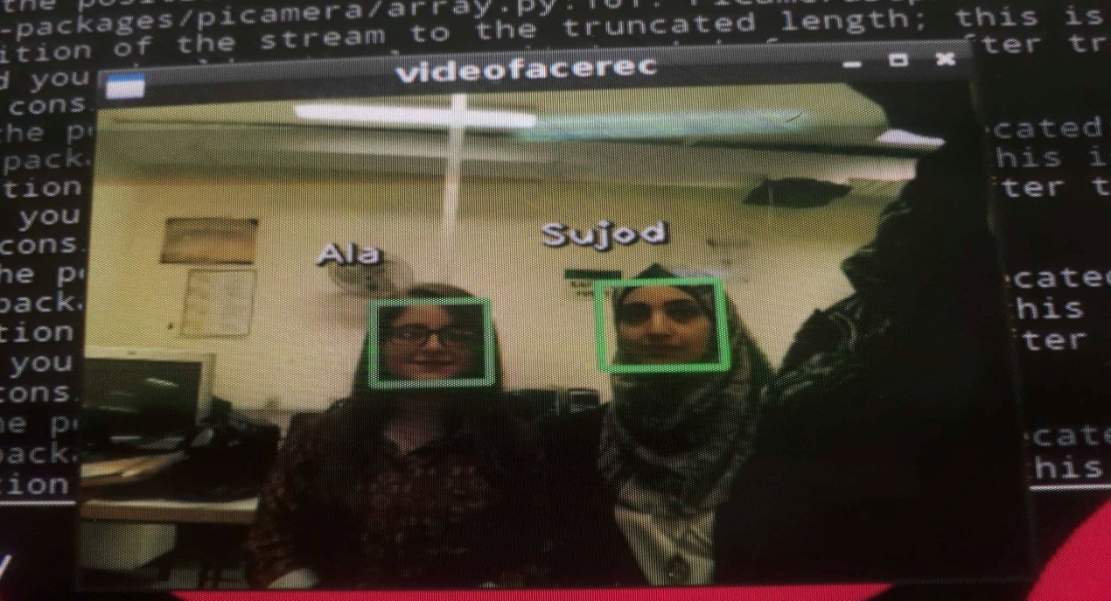
When we applied the openCV python code, the code was able to successfully recognize the faces.

Slide 16
Then the code will creates a text file for present students as shown:

Slide 17
Conclusion:
From our experiment, we noticed the face recognition was sensitive to face background, light, and head orientations. This technique described the accurate and efficient method of automatic attendance in the classroom which could replace the traditional method. An automatic attendance has many advantages, most of the existing systems are time consuming and require semi manual interference from lecturers, our system seeks to solve these issues by using face recognition in the process to save the time and labor. And No need for installing complex hardware for taking the attendance in classroom, all we need is a camera and laptop. We used algorithms that can detect and recognize faces in the image.

Slide 18
Future work
Automatic attendance system can be improved by increasing the number of features which can be extracted to increase accuracy of face recognition. Once the software is developed and tested properly, it could be improved to cover full institutions such as the faculty of engineering.

Slide 19


